Slide 1
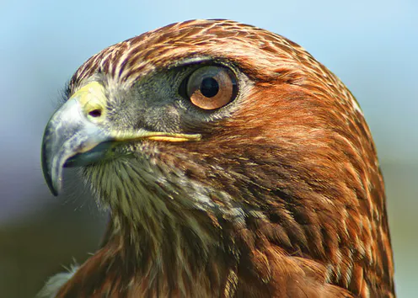

Sude Kosvalı
Sedef Uzunsakal
Mehmethan Sünnüoğlu
Yousef Elbayomi
Mahir Kara

Slide 2
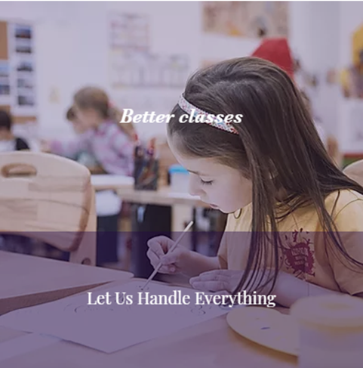
PRODUCT INFORMATION
HawkEye, is a camera which will be used in classes to provide a more effective education in schools.
It will be connected to the Internet and use Microsoft Azure API system to detect student’s emotions and relatively concentration levels.
It can detect how many students are in the class, and which people are in the class.

Slide 3

After the class it can send notifications to the teacher about:
Participations
Students’ general concentration
Their emotion levels in each day
Much other information depends on the necessities.
So that; the teachers can improve their teachings styles and provide more creative lectures according to the students’ mood.

Slide 4
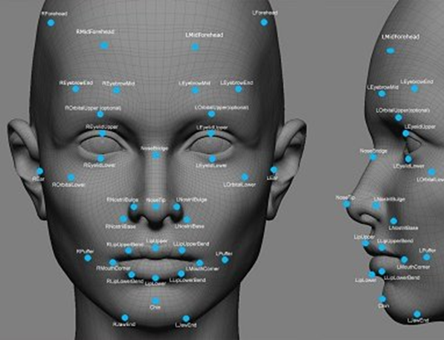

How it understand all?
Emotion is a significant part of a learners’ mental being, and it has a deep influence on the learners’ academic life and cognitive techniques of study and accomplishment.
Microsoft Azure API system records students’ faces and detects facial movements with webcam and measures their different emotion levels.

Slide 5
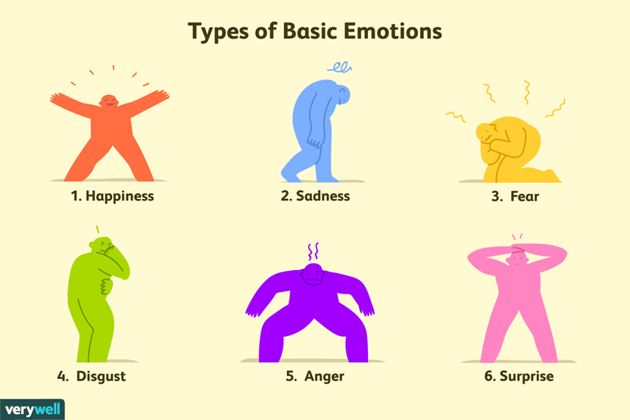
There is a profound relation between facial muscles movement and specific emotions, such as happiness, sadness, anger, fear, surprise, disgust and neutral.

Slide 6
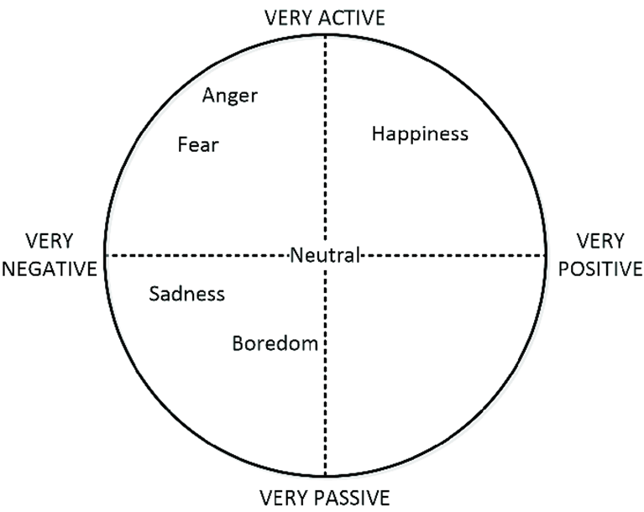
Scientific studies showed that the most concentrated state of a person is when his/her emotions are in neutral state.

Slide 7
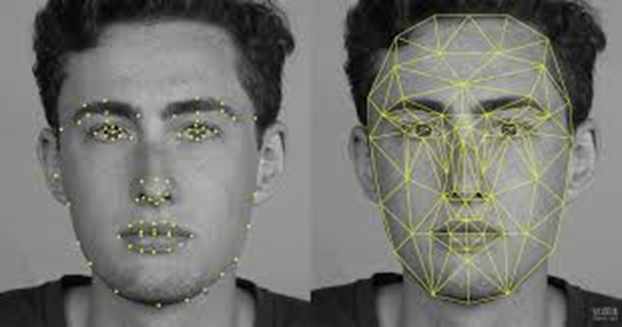
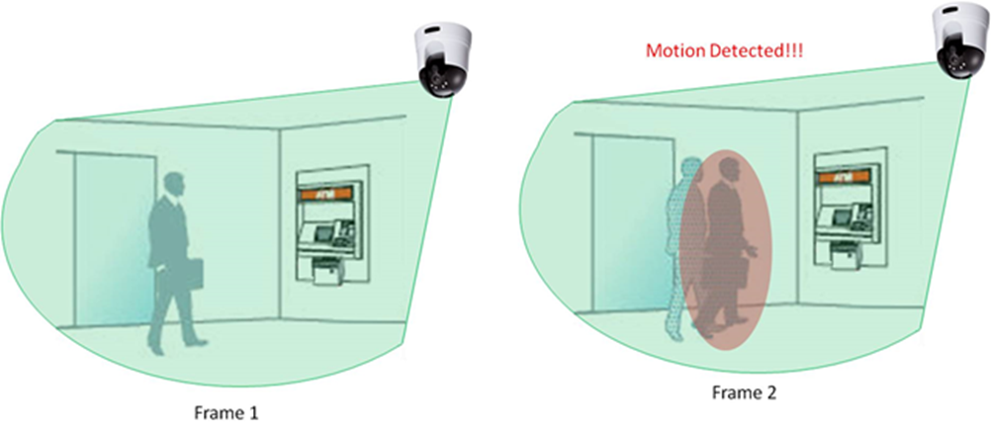
Features of HawkEye
Face Detection
Sound Detection
Motion Detection

Slide 8
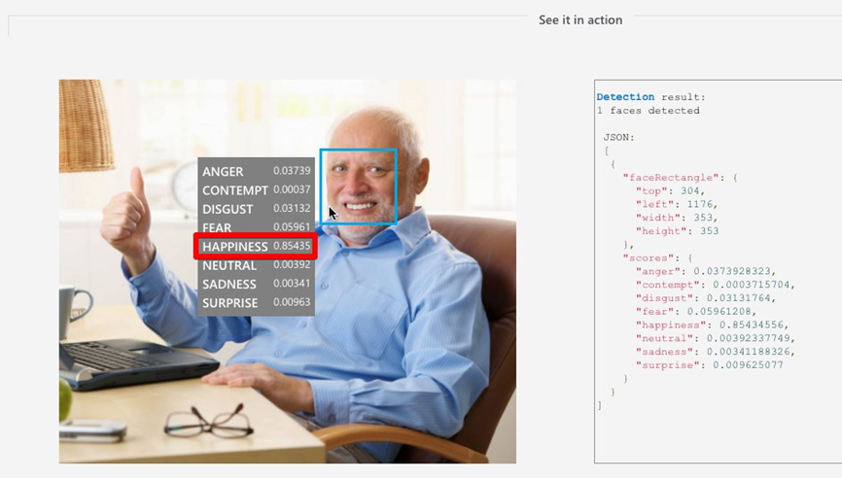
Detecting emotions of the students
Measuring concentration levels of the students

Slide 9

Saving each data for every second of the lessons
Analyzing averages and peaks of the emotion and concentration levels
Sending the results of the analyzed datas to the teachers

Slide 10
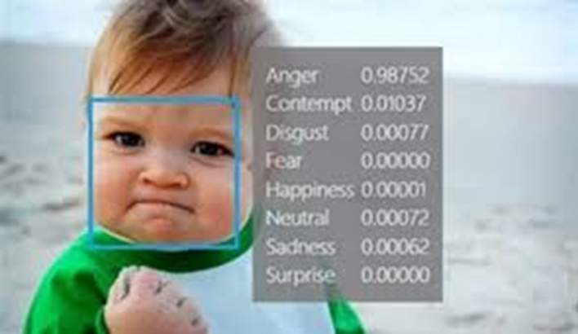
What is the aim of the usedge?
Firstly, most important goal is to recognize face from video..
Our goal is to reduce workload and waste of time.
Also it can good effect security and it can block illegal things it may happen.

Slide 11
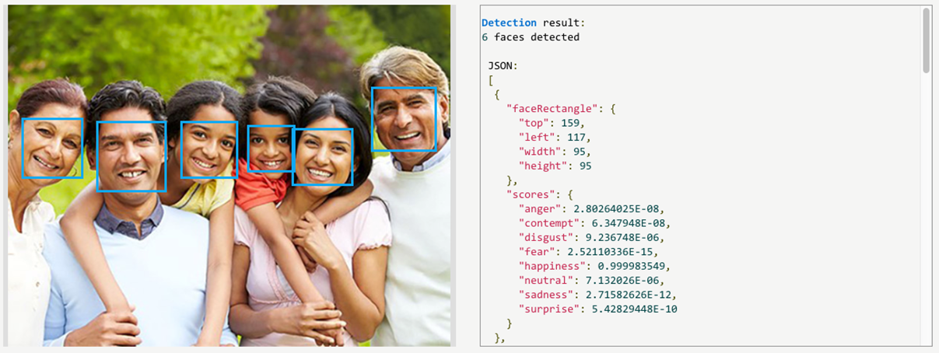
Where to use?
For instance, in classrooms to take attendence and to capture cheating or to catch the attention of the students is dispersed which minutes of the lesson.
On streets or shopping centers may use it for capture someone who doing something illegal things.

Slide 12

What are the effects on humans?
You know that safety is very important for people, this production provide this so people can act more relax.
Parents send their children to school and they can feel more safety and relax about their children because of HawkEye.
Teachers do not have to wait near the students in exam or teacher do not have to attendence.
On the other hand People will not be uneasy on the streets.Like I said people can feel more comfortable when going outside.

Slide 13

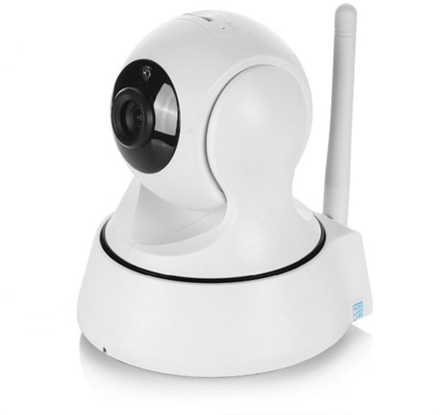
Price and Place
The usage area of our product will be mostly schools. Since the product will be sold to school, we have compared its pricing with security cameras.
However, since our product will have superior and digital features compared to security cameras, the price will be higher than them.

Slide 14


So our product will be high priced and high quality. According to our researches, the total cost of our product is 330 TL.
Accordingly, our product’s initial sales price will be 499 TL.
The sales points of our product will be sold in technology stores as well as in majör markets such as Macro Center and Migros.

Slide 15

Since the size of our product is small and there is no limitation on the usage time, the cost of storing it will be low.
We decided to have the main warehouse in Maltepe due to both logistical cost and population distribution.

Slide 16

This transportation from the main warehouse to Anatolia, Trakya and Ege region will be much more advantageous than other places in terms of transportation conditions and fees.
In addition, due to its close proximity to Sabiha Gokcen Airport, Tuzla Marina and Pendik Railway Station, shipments to abroad will be easy and cost-effective.

Slide 17
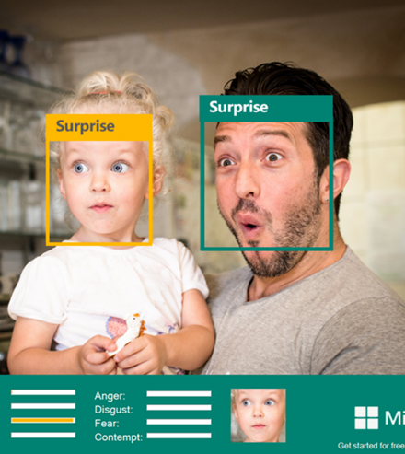
Digital Marketing
As in any application, site, idea, etc., you must market your project when it is completed.
In our project, we did not actually build something, but in return we created websites to communicate and decided to market these sites.

Slide 18

HawkEye’s Website
We decided to create a site that supports our idea and makes it easier for us to communicate with all customers.
On the site we explained what is our idea and what are the goals we want to reach, We also indicated the place to be our university because it is the place where the idea was born.
We also put many ways of communication such as email, Instagram, and messages through the site so that we can serve customers in the fastest time.

Slide 19

QR Code
As always, the QR code is required when we talk about e-marketing. Therefore we had to do some QR codes, we did for Instagram and a site as well, in addition to that we did one to merge them together.
As studies have indicated, the general majority prefers direct QR codes (i.e. meaning that leads directly to the target) and therefore our focus will be more directed on the two direct codes, but for the indirect code it may be useful to us later in the event that we expand more and we have a lot of accounts in Social Media

Slide 20
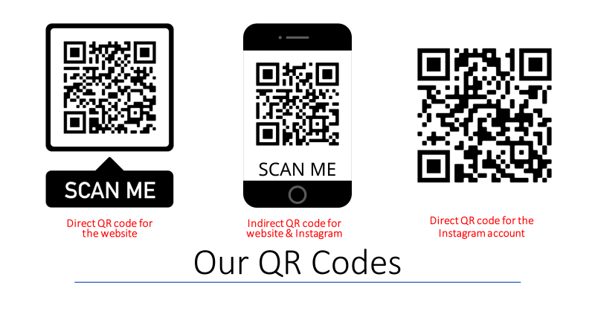

Slide 21
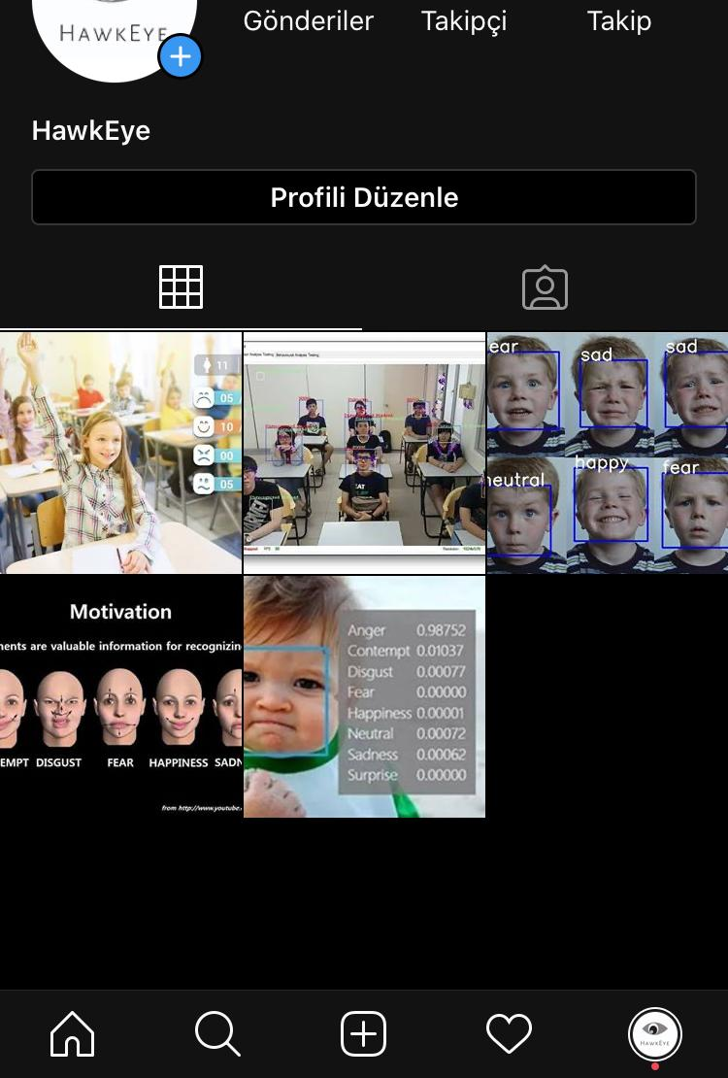
Social Media
INSTAGRAM:
https://www.instagram.com/hawkeye1588/?hl=tr
By using more visual, we aim to stay in the customer's mind.
The customer can learn more about the content.
Since the product is technological, every new development can be accessed through this channel.

Slide 22
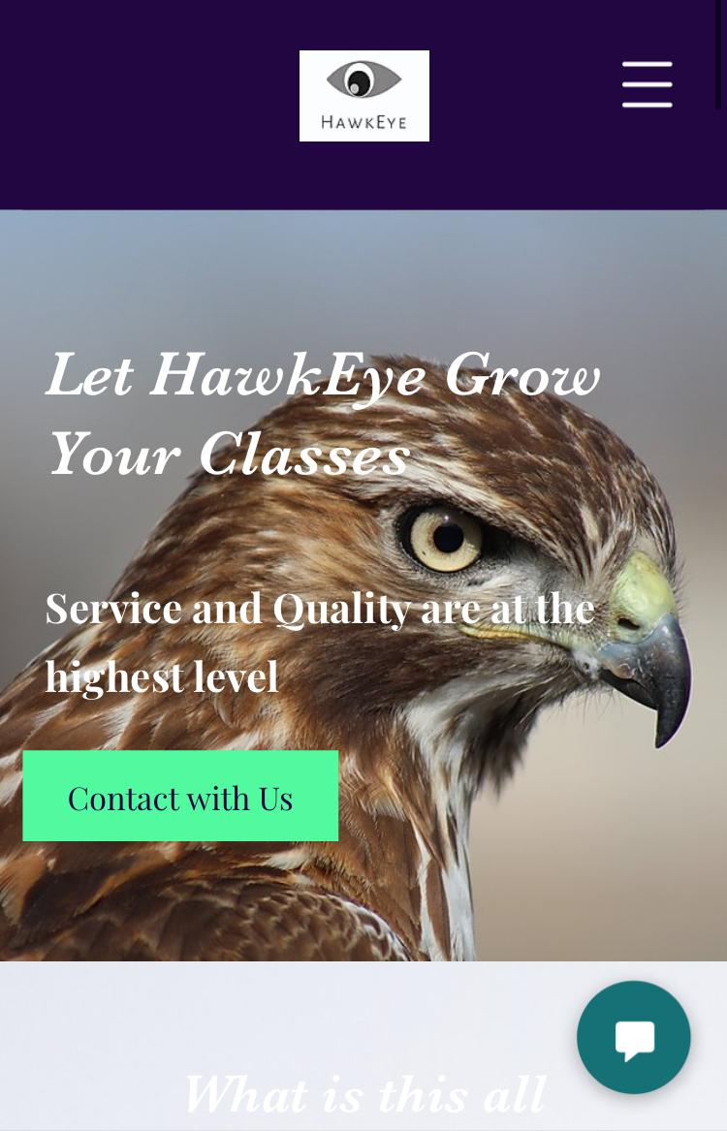
WEBSITE:
https://hawkeye1588.wixsite.com/hawkeye1588
Everything about the product can be learned from the site.
We want our technological product to develop every day, so we care about all customer complaints and suggestions.
Anyone can contact us through our website.

Slide 23
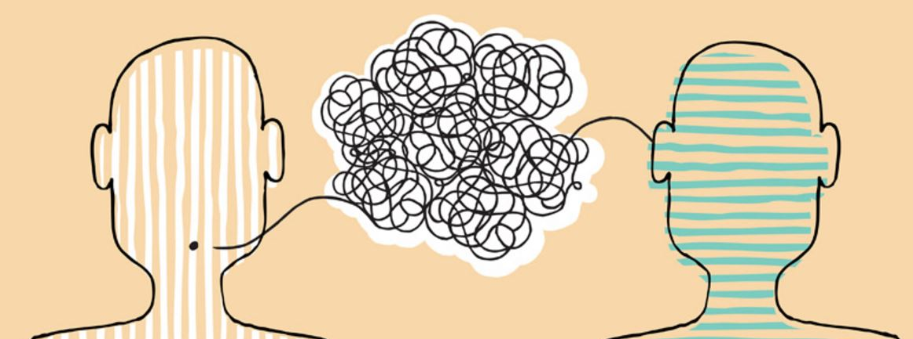
THANK YOU ☺

